Slide 1
Activity 1: Plants in the Dark Investigation

Slide 2
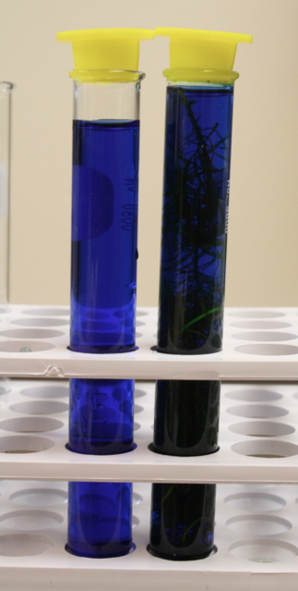
Plants in the Dark Investigation
Now that you have set up your investigation, what do you think will happen? Why?
?
dark

Slide 3
Possible BTB Colors

Slide 4
Record your observations of color change here.
 | Test Tube With Plant |  | Control
 | Start BTB Color | End BTB Color | Start BTB Color | End BTB Color
1 | Blue |  | Blue
2 | Blue |  | Blue
3 | Blue |  | Blue
4 | Blue |  | Blue
5 | Blue |  | Blue
6 | Blue |  | Blue
7 | Blue |  | Blue

Slide 5
Explaining your Results
What are your observations of color change?
How can you explain these observations?
What happened?
Why did that happen?
What unanswered questions do you have?
Notes:
Answer these questions as a class. Alternatively, you can write these results on the class poster in PlantsPosters.pptx or in PlantsClassResults.xlsx.

Slide 6
Activity 2: Modeling Cellular Respiration in Plants
How do plants move?

Slide 7
Three processes help us understand how plants move: Photosynthesis Biosynthesis Respiration
Notes:
Animal PPT: cow
Share the frame by the end of weekend

Slide 8
Three processes help us understand how plants move: Photosynthesis Biosynthesis 3. Respiration
Notes:
Animal PPT: cow
Share the frame by the end of weekend

Slide 9
Respiration happens when a plant cell uses sugar and oxygen to create water, carbon dioxide, and heat energy.
Notes:
Animal PPT: cow
Share the frame by the end of weekend

Slide 10
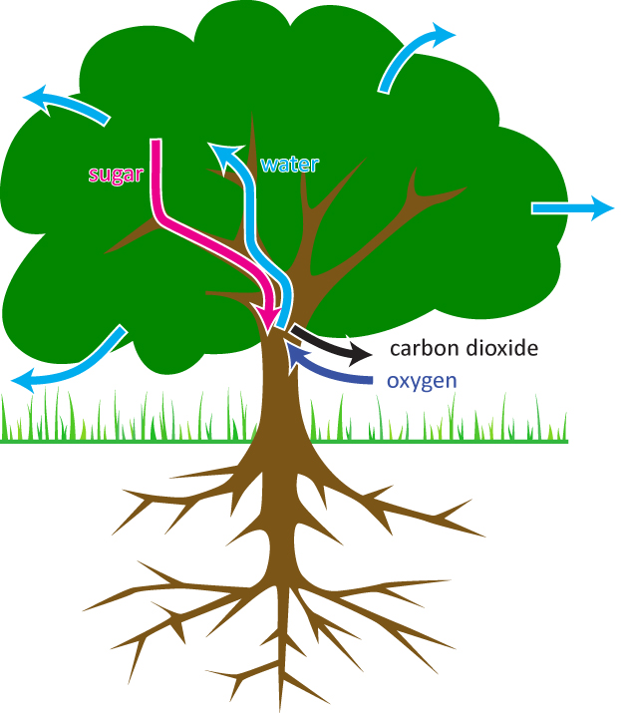
Movement during cellular respiration

Slide 11
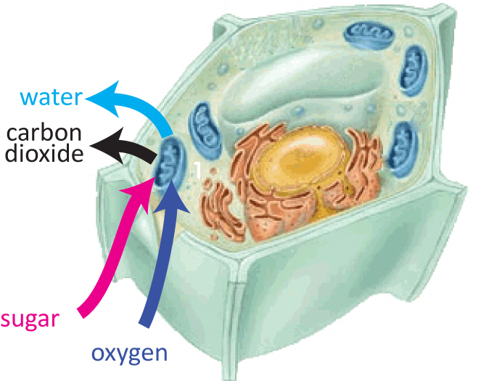
Movement during cellular respiration

Slide 12
How Atoms Bond Together in Molecules
Atoms in stable molecules always have a certain number of bonds to other atoms:
Carbon: 4 bonds
Oxygen: 2 bonds
Hydrogen: 1 bond
Oxygen atoms do NOT bond to other oxygen atoms if they can bond to carbon or hydrogen instead.
Chemical energy is stored in bonds between atoms
Some bonds (C-C and C-H) have high chemical energy
Other bonds (C-O and O-H) have low chemical energy

Slide 13
Making the Reactant Molecules: Sugar and Oxygen
Cellular respiration occurs when sugar (C₆H₁₂O₆) reacts with oxygen (O₂). Make a molecules of sugar and oxygen on the reactant side of your Molecular Models poster:
Get the atoms you will need to make your molecules. Can you figure out from the formula for sugar how many C, H, and O atoms you will need?
Use the bonds to make models of a sugar molecule (C₆H₁₂O₆) and at least 6 oxygen molecules (O₂, with a double bond)
Identify the high-energy bonds (C-C and C-H) by putting twisty ties on them. How many high energy bonds does a molecule of sugar have?
Compare your molecules to the pictures on the next slide. Are they the same?

Slide 14
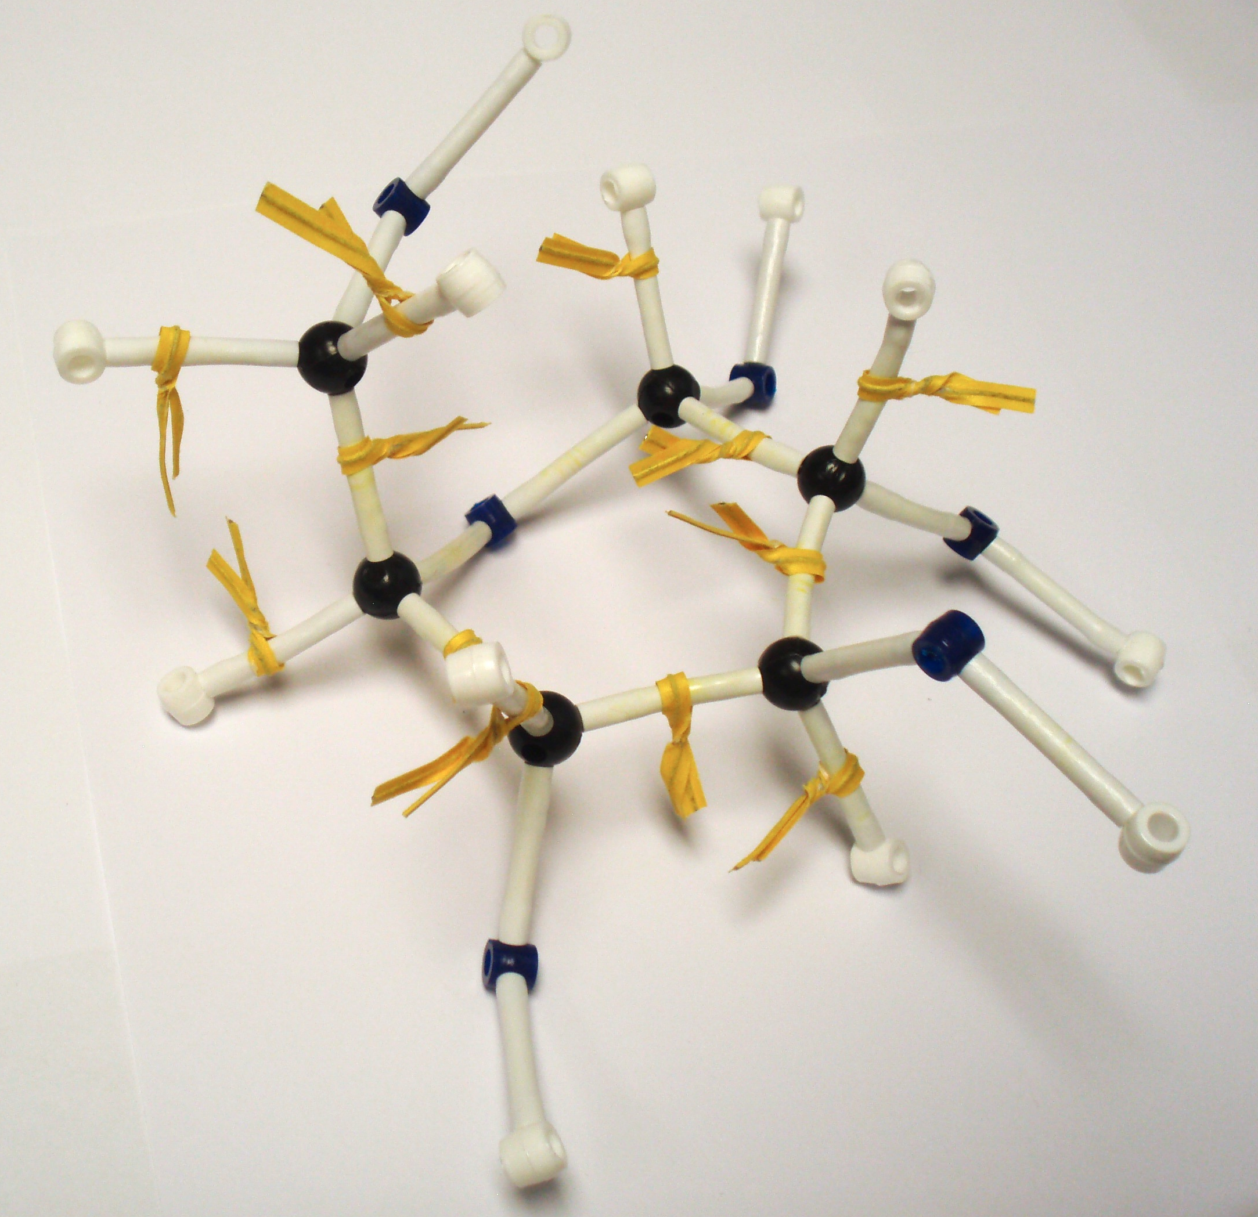
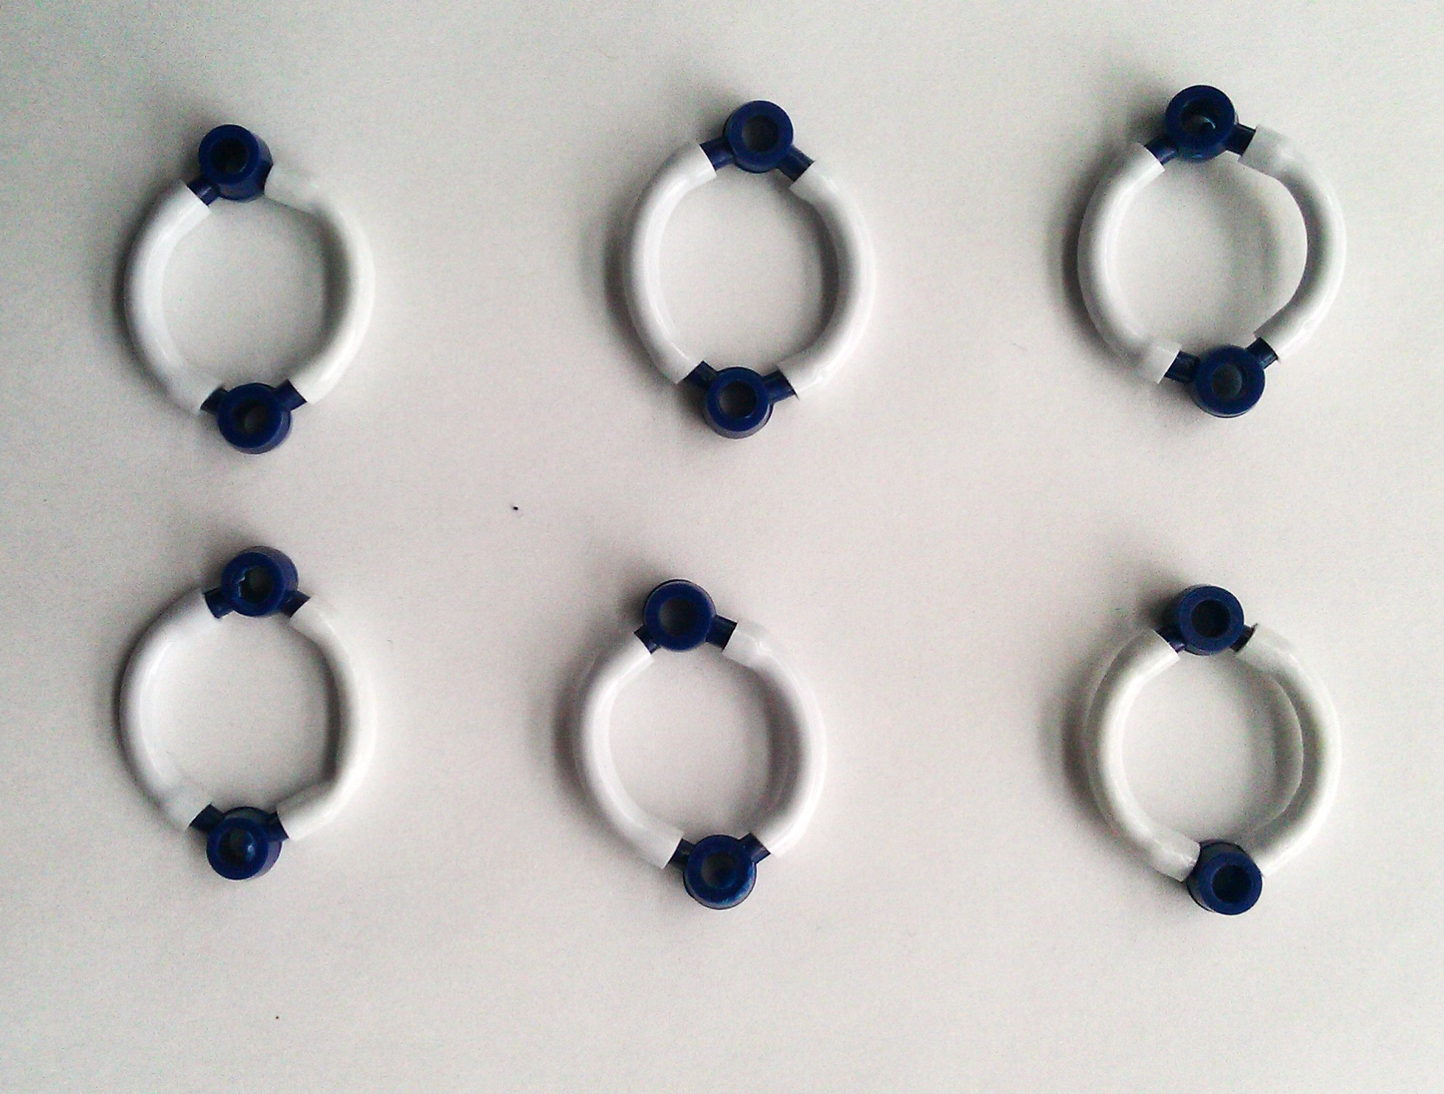
Photo of reactant molecules: C₆H₁₂O₆ (sugar) Start by making the molecules and energy units of the reactants and putting them on the reactants side, then rearrange the atoms and energy units to show the products.
Glucose with Chemical Energy
Chemical change
Oxygen
Reactants
Products
Remember: Atoms last forever (so you can rearrange atoms into new molecules, but can’t add or subtract atoms)
Energy lasts forever (so you can change forms of energy, but energy units can’t appear or go away)

Slide 15
Rearranging the Atoms to Make Product Molecules: Carbon Dioxide and Water
Cellular respiration occurs when sugar (C₆H₁₂O₆) reacts with oxygen (O₂) to produce carbon dioxide (CO₂) and water (H₂O). Show how this can happen:
The reaction breaks the bonds in the molecules, so their bonds can break. Now they can recombine into carbon dioxide (CO₂) and water vapor (H₂O). Make as many of these molecules as you can from one sugar molecule.
Figure out numbers of molecules:
How many O₂ molecules do you need to combine with one sugar molecule?
How many CO₂ and H₂O molecules are produced by respiring one molecule?
Remember, atoms last forever. So you can make and break bonds, but you still need the same atoms.
Remember, energy lasts forever. What forms of energy do the twisty ties represent now?
Compare your molecules to the pictures on the next slide. Are they the same?

Slide 16
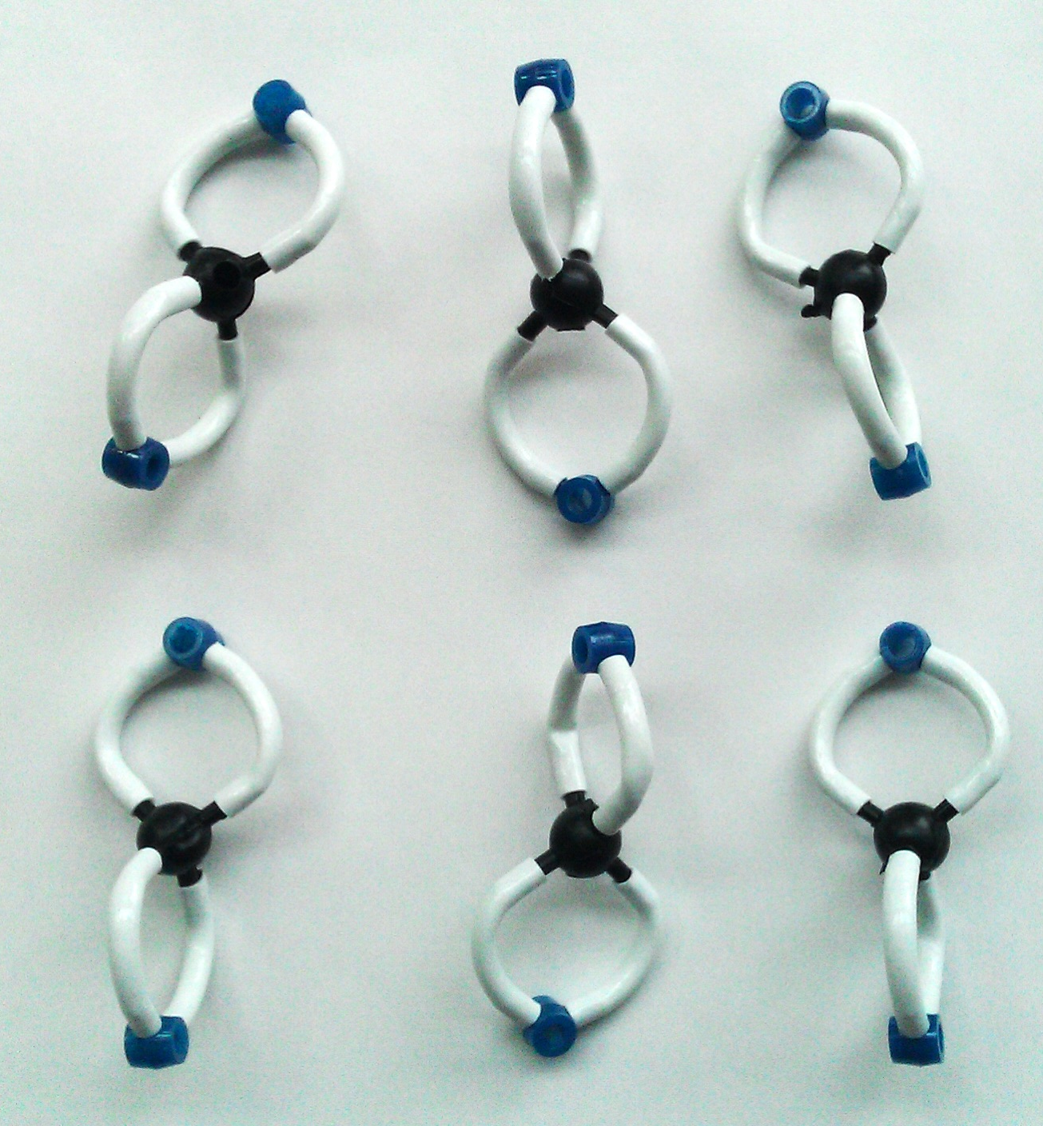
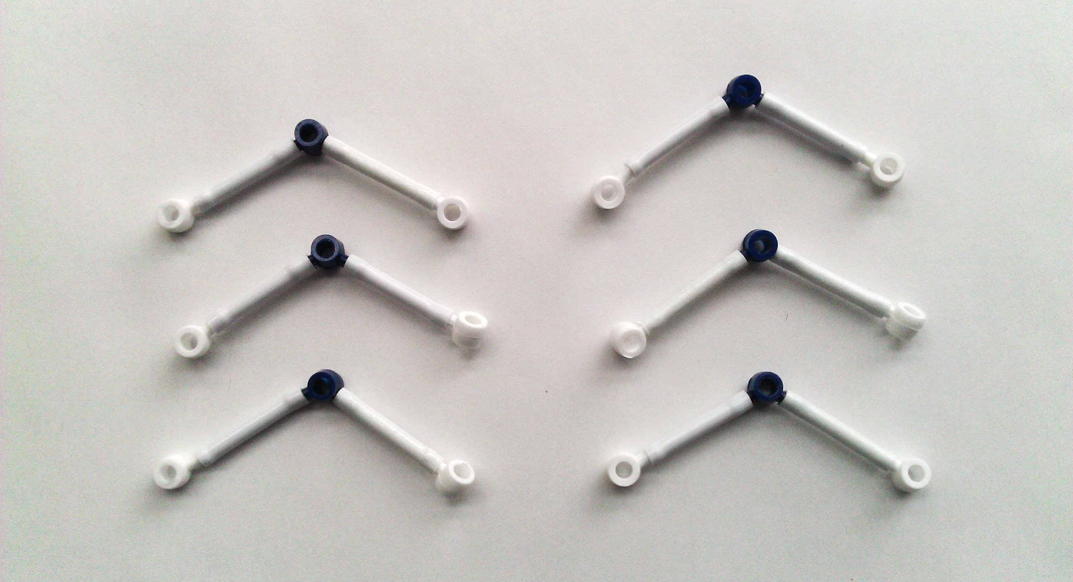
Photo of product molecules CO₂ and H₂O (carbon dioxide and water) Start by making the molecules and energy units of the reactants and putting them on the reactants side, then rearrange the atoms and energy units to show the products.
Carbon dioxide
Chemical change
Water
Heat / work
Reactants
Products
Remember: Atoms last forever (so you can rearrange atoms into new molecules, but can’t add or subtract atoms)
Energy lasts forever (so you can change forms of energy, but energy units can’t appear or go away)

Slide 17
Comparing photos of reactant and product molecules Start by making the molecules and energy units of the reactants and putting them on the reactants side, then rearrange the atoms and energy units to show the products.
Carbon dioxide
Glucose with Chemical Energy
Chemical change
Water
Oxygen
Heat / work
Reactants
Products
Remember: Atoms last forever (so you can rearrange atoms into new molecules, but can’t add or subtract atoms)
Energy lasts forever (so you can change forms of energy, but energy units can’t appear or go away)

Slide 18
Writing a Chemical Equation
Chemists use chemical equations to show how atoms of reactant molecules are rearranged to make product molecules
Writing the equation in symbols: Chemists use an arrow to show how reactants change into products: [reactant molecule formulas] →product molecule formulas]
Saying it in words: Chemists read the arrow as “yield” or “yields:” [reactant molecule names] yield [product molecule names]
Equations must be balanced: Atoms last forever, so reactant and product molecules must have the same number of each kind of atom
Try it: can you write a balanced chemical equation to show the chemical change when animals move (use energy)?

Slide 19
Chemical equation for cellular respiration
C₆H₁₂O₆ + 6O₂ → 6 CO₂ + 6 H₂O
(in words: sugar reacts with oxygen to yield carbon dioxide and water)

Slide 20
Three Questions Poster
Question | Rules to Follow | Evidence to Look For
The Movement Question: Where are atoms moving? Where are atoms moving from? Where are atoms going to? | Atoms last forever in combustion and living systems All materials (solids, liquids, and gases) are made of atoms | When materials change mass, atoms are moving When materials move, atoms are moving
The Carbon Question: What is happening to carbon atoms? What molecules are carbon atoms in before the process? How are the atoms rearranged into new molecules? | Carbon atoms are bound to other atoms in molecules Atoms can be rearranged to make new molecules | The air has carbon atoms in CO₂ Organic materials are made of molecules with carbon atoms Foods Fuels Living and dead plants and animals
The Energy Question: What is happening to chemical energy? What forms of energy are involved? How is energy changing from one form to another? | Energy lasts forever in combustion and living systems C-C and C-H bonds have more stored chemical energy than C-O and H-O bonds | We can observe indicators of different forms of energy Organic materials with chemical energy Light Heat energy Motion

Slide 21
Can you answer the Three Questions for cellular respiration now?
What are your ideas?
The Movement Question: Where atoms moving? (Where are atoms moving from? Where are atoms going to?)
The Carbon Question: What is happening to carbon atoms? (What molecules are carbon atoms in before the process? How are the atoms rearranged into new molecules?)
The Energy Question: What is happening to chemical energy? (What forms of energy are involved? How is energy changing from one form to another?)

Slide 22
What happens when animals move (use energy)?
Where are atoms moving from?
Where are atoms moving to?
Chemical change
What molecules are carbon atoms in before the change? What other molecules are involved?
What molecules are carbon atoms in after the change? What other molecules are produced?
What forms of energy are in the reactants?
What forms of energy are in the products?
Remember: Atoms last forever (so you can rearrange atoms into new molecules, but can’t add or subtract atoms) Energy lasts forever (so you can change forms of energy, but energy units can’t appear or go away)
Notes:
Teaser process tool for all investigations except soda water

Slide 23
The End

Slide 24
Movement of atoms during Respiration
water
Glucose
(from cells to air)
(already Inside the tree from photosynthesis)
carbon dioxide
oxygen
(From air to cells)
(From cells to air)

Slide 25
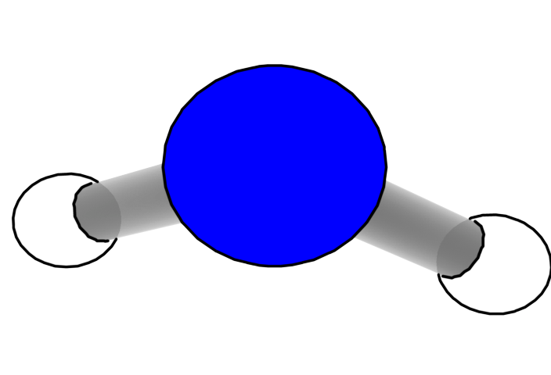
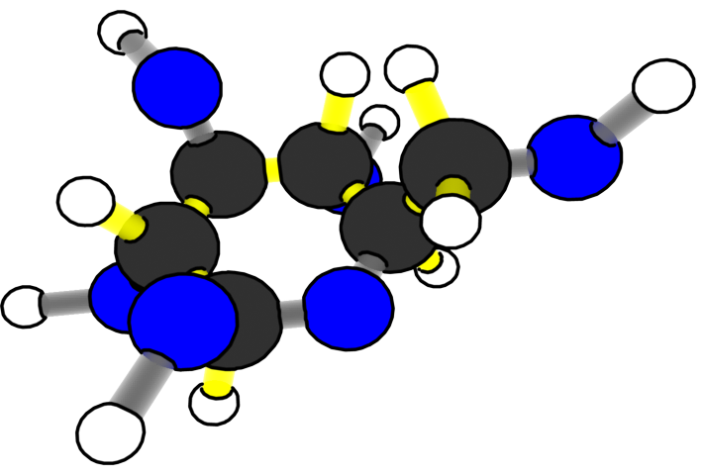
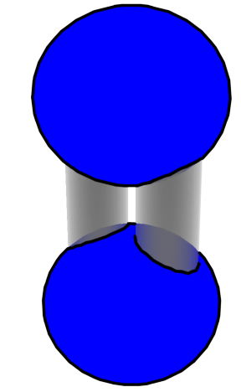
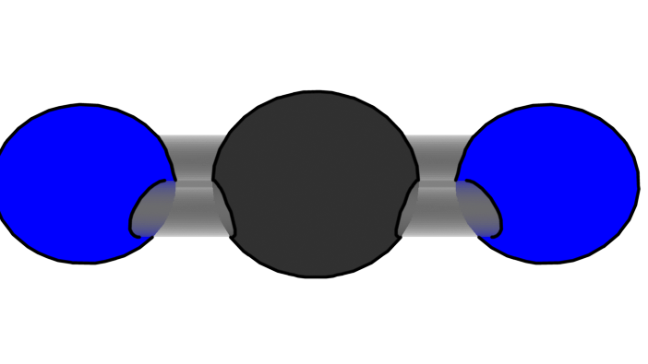
Movement of atoms during respiration
Energy forms
Energy movement
Energy Transformation
C₆H₁₂O₆
H₂O
O₂
CO₂
Notes:
It need to change the products and reactants. Show arrow of movement, change the chemical formulas

